Slide 1
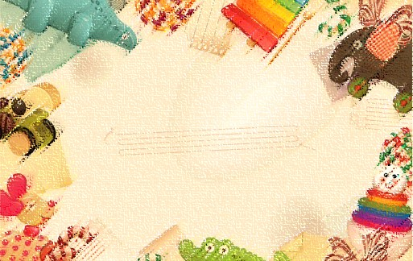
教育部 104年數位學伴線上課業輔導服務計畫
教學科目：英文 教學單元：Wh問句-when 教學者： 學習者：

Slide 2
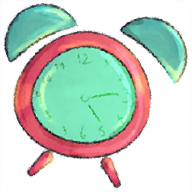




What time is it?

Slide 3
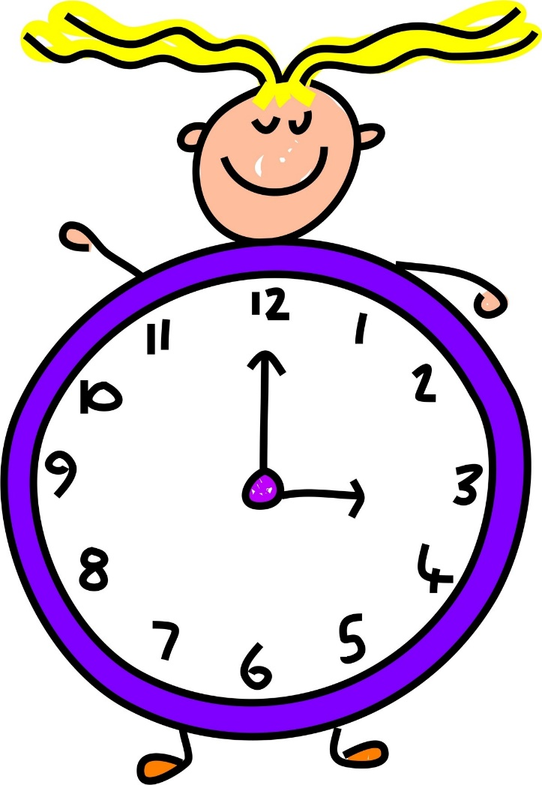
What time is it?
It’s ______o’clock.
It’s 9:32. (night thirty-two)

Slide 4
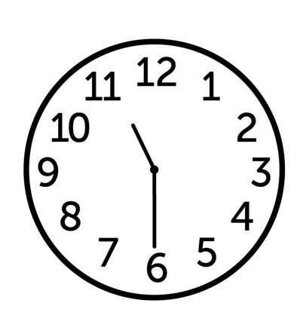
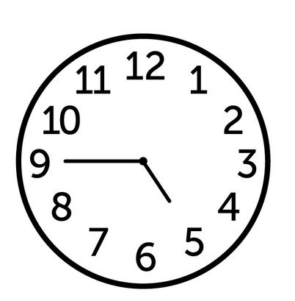
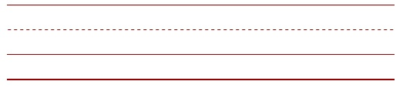
What time is it?

Slide 5
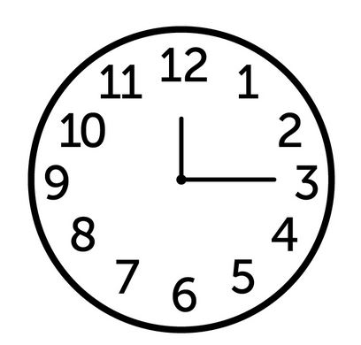
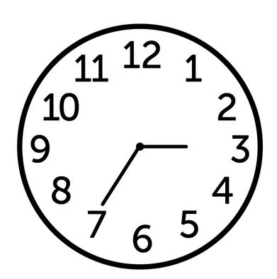
What time is it?

Slide 6
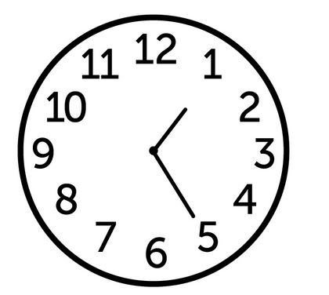
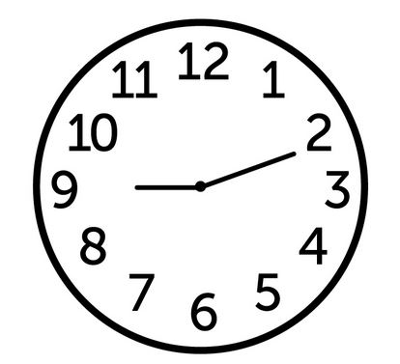
What time is it?

Slide 7
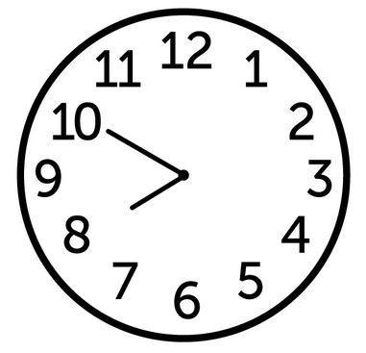
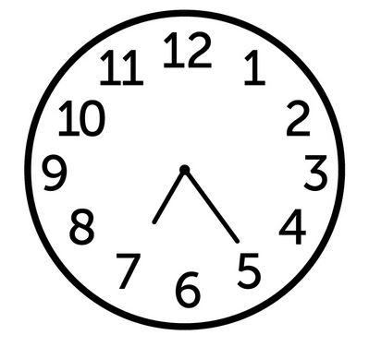
What time is it?

Slide 8
When的疑問句
when | 助動詞do/does | S | 動詞
when |  | I | go home | ?
 |  | you | go to school
 |  | he/she/it | go to sleep
 |  | we | go to picnic
 |  | you | take the bus
 |  | they | do the homework
 |  | Amy | play the guitar

Slide 9
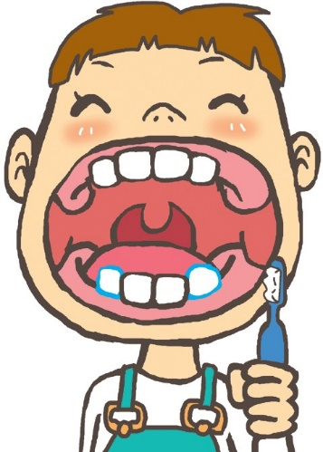

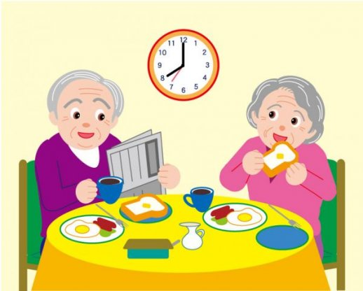

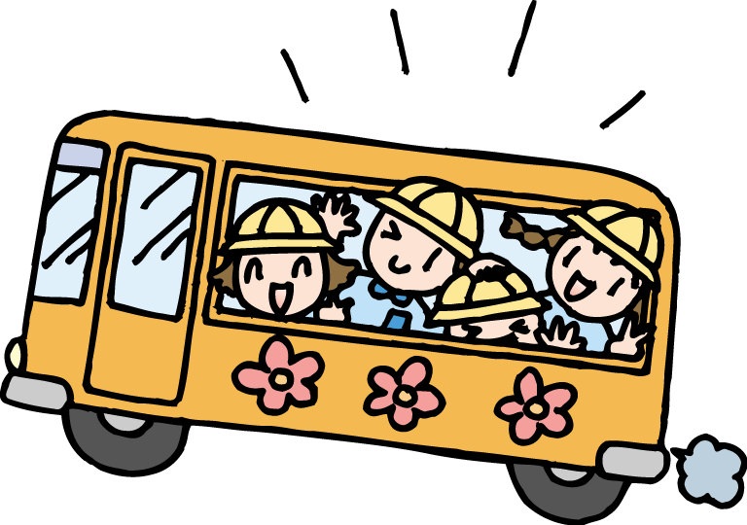

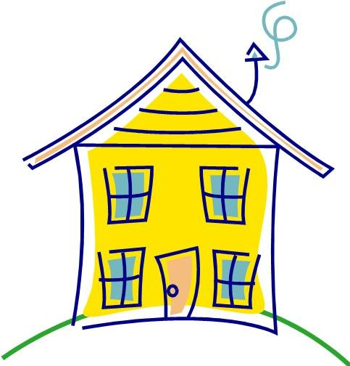

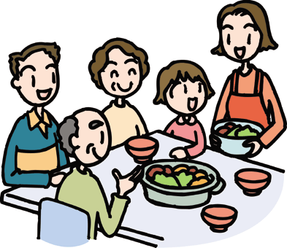
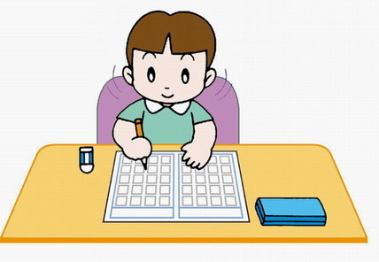

Slide 10
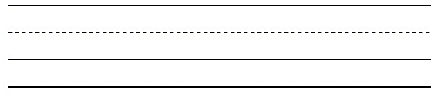
When do he brush the teethes?
He brush the teethes at 8 o’clock.

Slide 15
教材設計：台灣偏鄉教育關懷中心
教材參考：博幼社會福利基金會免費教學資源
★ 教材僅供公益線上學習陪伴上課使用，不做商業用途 ★

